Slide 1

ngular
Training – Day 02
Laxman Dasari

Slide 2
Learning Topics
Overview of Angular
History of Angular
Hello ngWorld!
Structure of Application
Angular Architecture
Building Blocks
Angular CLI

Slide 3
What is Angular?

Slide 4
“Powerful JavaScript framework to develop single page applications based on MV* architecture pattern using HTML, CSS and JavaScript”

Slide 5
“Powerful JavaScript framework to develop single page applications based on MV* architecture pattern using HTML, CSS and JavaScript”

Slide 6
Why Angular?

Slide 7
Simpler and Faster
TypeScript Based
Supports latest as well as old browsers
Mobile First
Cross Platform
Speed and Performance
MV* architecture pattern
Better tooling support
Better unit testing support

Slide 8
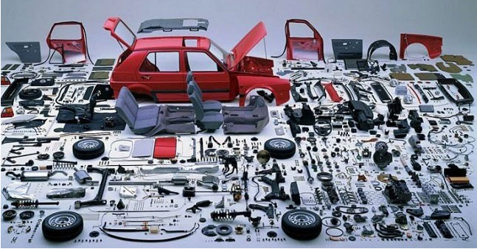
Component Based

Slide 9
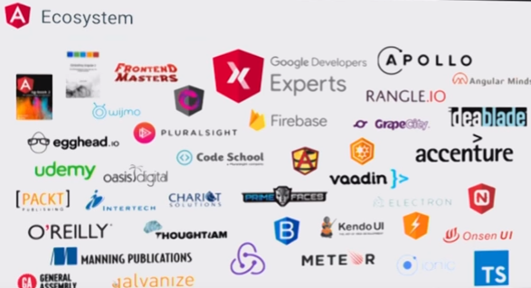
Better Ecosystem

Slide 10
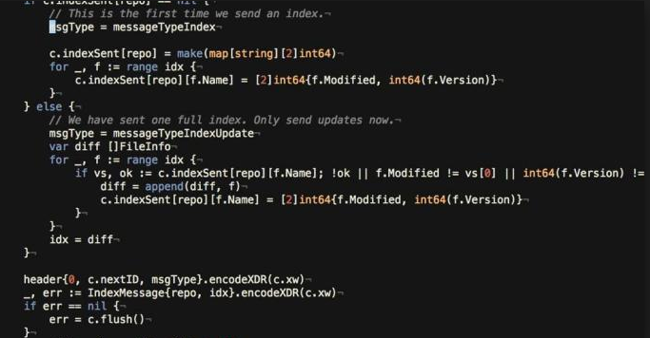
Open Source

Slide 11


Slide 12
Cross Platform
Progressive web apps
Use modern web platform capabilities to deliver app-like experiences. High performance, offline, and zero-step installation
Native
Build native mobile apps with strategies from Ionic Framework, NativeScript, and React Native
Desktop
Create desktop-installed apps across Mac, Windows, and Linux using the same Angular methods you've learned for the web plus the ability to access native OS APIs.

Slide 13
Speed and Performance
Code generation
Angular turns your templates into code that's highly optimized for today's JavaScript virtual machines, giving you all the benefits of hand-written code with the productivity of a framework
Universal
Serve the first view of your application on node.js, .NET, PHP, and other servers for near-instant rendering in just HTML and CSS. Also paves the way for sites that optimize for SEO
Code Splitting
Angular apps load quickly with the new Component Router, which delivers automatic code-splitting so users only load code required to render the view they request.

Slide 14
Productivity
Templates
Quickly create UI views with simple and powerful template syntax
Angular CLI
Command line tools: start building fast, add components and tests, then instantly deploy
IDEs
Get intelligent code completion, instant errors, and other feedback in popular editors and IDE

Slide 15
Full Development Story
Testing
With Karma for unit tests, you can know if you've broken things every time you save. And Protractor makes your scenario tests run faster and in a stable manner
Animation
Create high-performance, complex choreographies and animation timelines with very little code through Angular's intuitive ApI
Accessibility
Create accessible applications with ARIA-enabled components, developer guides, and built-in a11y test infrastructure

Slide 16
History

Slide 17
Created as a side project in 2009 by two google developers
Misko Hevery and Adam Abrons

Slide 18
Originally named as GetAngular

Slide 19
AngularJS V 1.0.0 in September 2012

Slide 20
Announced Angular2 in 2014 ngConf

Slide 21
Angular2 is complete rewrite of Angular1
Completely different architecture

Slide 22
Angular2 launched in September 2016

Slide 23
Proposed schedule of Future Releases
Sep-2012 | 1.0.0
Sep-2016 | 2.0.0
Mar-2017 | 4.0.0
Sep-2017 | 5.0.0
Mar-2018 | 6.0.0
Sep-2018 | 7.0.0

Slide 24

1.x
2+
AngularJS
Angular

Slide 25
Where is Angular 3?

Slide 26
Hello ngWorld!

Slide 27

Structure of an Application
Template
Component
Directives
Module fnX
Template
Directives
Component
Module root
(App Module)
Template
Component
Main.ts
(Bootstrap)

Slide 28
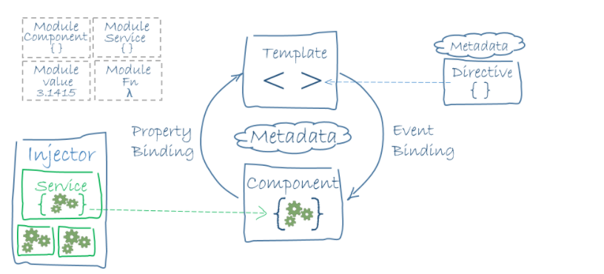
Big Picture

Slide 29
Building Blocks
Modules
Angular apps are modular
Components
A component controls a patch of screen called a view
Templates
HTML view of component
Metadata
Metadata tells Angular how to process a class
Data Binding
coordinating parts of a template with parts of a component
Directives
Gives instruction to transform DOM
Services
A service is typically a class with business logic
Dependency Injection
Supplies new instances of class with fully-formed dependencies

Slide 30
Reference Materials
https://angular.io
https://github.com/angular/angular
https://github.com/angular/quickstart
https://app.pluralsight.com/library/courses/angular-2-getting-started-update/table-of-contents

Slide 31
THANK YOU
Happy Learning!
Laxman

